Slide 1
"Digital Media Primer" Yue-Ling Wong,
Copyright (c)2013 by Pearson Education, Inc. All rights reserved.

Slide 2
Chapter 4
Fundamentals of Digital Audio
Part 2
Digitizing Sound

Slide 3
In this lecture, you will find answers to these questions:
What does digitizing audio mean?
How is sound sampled and quantized in the digitization process?
How are sampling rate, bit depth, and resolution related to sampling and quantizing?
How do the choices of the sampling rate and bit depth affect the sound fidelity and details?

Slide 4
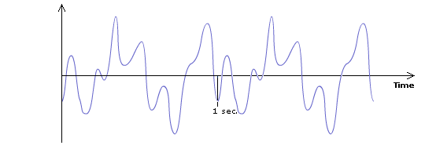
Digitizing Sound
Suppose we want to digitize this sound wave:

Slide 5
Step 1. Sampling
The sound wave is sampled at a specific rate into discrete samples of amplitude values.

Slide 6
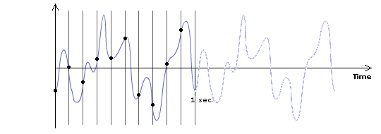
Step 1. Sampling
The sound wave is sampled at a specific rate into discrete samples of amplitude values.
Suppose we sample the waveform 10 times a second, i.e., sampleing rate = 10 Hz.

Slide 7
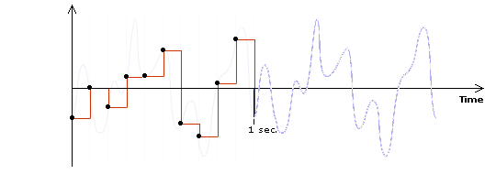
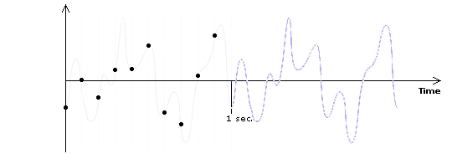
Step 1. Sampling
The sound wave is sampled at a specific rate into discrete samples of amplitude values.
Suppose we sample the waveform 10 times a second, i.e., sampleing rate = 10 Hz.
We get 10 samples per second.

Slide 8
Step 1. Sampling
The sound wave is sampled at a specific rate into discrete samples of amplitude values.
Reconstructing the waveform using the discrete sample points.

Slide 9
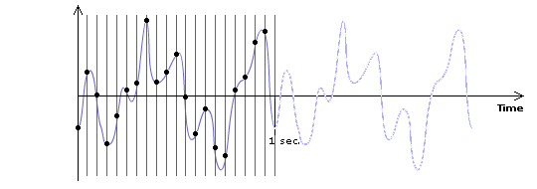
Step 1. Sampling
What if we sample 20 times a second, i.e., sampling rate = 20 Hz?

Slide 10
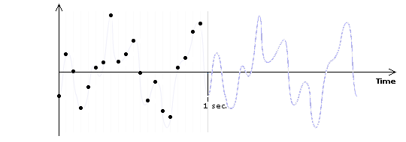
Step 1. Sampling
What if we sample 20 times a second, i.e., sampling rate = 20 Hz?
We get 20 samples per second.

Slide 11
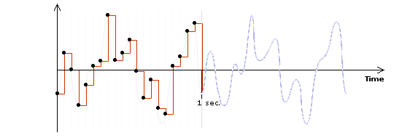
Step 1. Sampling
What if we sample 20 times a second, i.e., sampling rate = 20 Hz?
Reconstructing the waveform using the discrete sample points.

Slide 12
Effects of Sampling Rate
original waveform
sampling rate = 10 Hz
sampling rate = 20 Hz

Slide 13
Effects of Sampling Rate
Higher sampling rate:
The reconstructed wave looks closer to the original wave
More sample points, and thus larger file size

Slide 14
Sampling Rate Examples
11,025 Hz AM Radio Quality/Speech
22,050 Hz Near FM Radio Quality (high-end multimedia)
44,100 Hz CD Quality
48,000 Hz DAT (digital audio tape) Quality
96,000 Hz DVD-Audio Quality
192,000 Hz DVD-Audio Quality

Slide 15
Sampling Rate vs. Sound Frequency
Both uses the unit Hz
BUT:
sampling rate ≠ sound frequency
Sample rate: a setting in the digitization process
Sound frequency: NOT a setting in the digitization process
Sound frequency: the pitch characteristic of sound
Higher sampling rate: NOT the pitch characteristic of sound

Slide 16
Step 2. Quantization
Each of the discrete samples of amplitude values obtained from the sampling step are mapped and rounded to the nearest value on a scale of discrete levels.
The number of levels in the scale is expressed in bit depth--the power of 2.
An 8-bit audio allows 2⁸ = 256 possible levels in the scale
CD-quality audio is 16-bit (i.e., 2¹⁶ = 65,536 possible levels)

Slide 17
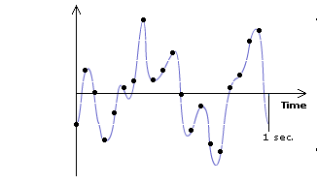
Step 2. Quantization
Suppose we are quantizing the samples using 3 bits (i.e. 2³ = 8 levels).

Slide 18
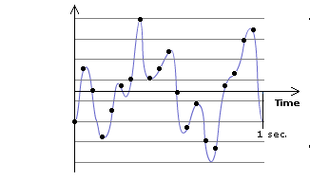
Step 2. Quantization
Suppose we are quantizing the samples using 3 bits (i.e. 2³ = 8 levels).

Slide 19
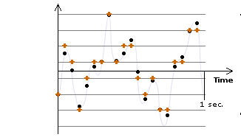
Step 2. Quantization
Now, round each sample to the nearest level.

Slide 20
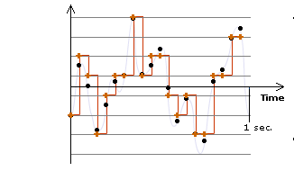
Step 2. Quantization
Now, reconstruct the waveform using the quantized samples.

Slide 21
Effects of Quantization
Data with different original amplitudes may be quantized onto the same level
⇒ loss of subtle differences of samples
With lower bit depth, samples with larger differences may also be quantized onto the same level.

Slide 22
Bit Depth
Bit depth of a digital audio is also referred to as resolution.
For digital audio, higher resolution means higher bit depth.

Slide 23
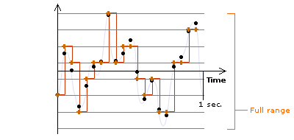
Dynamic Range
The range of the scale, from the lowest to highest possible quantization values
In the previous example:

Slide 24
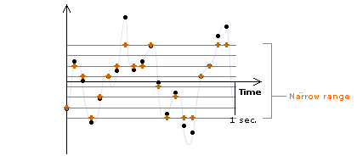
Smaller than the Full Range

Slide 25
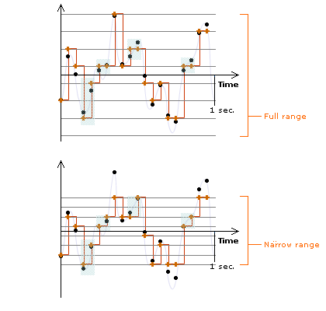

Slide 26
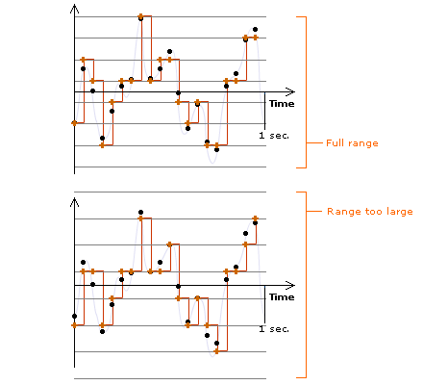

Slide 27

An interactive tutorial illustrating the following sections on sampling and quantizing in digitizing a sound wave.
Also see the interactive tutorial:
SAMPLING AND QUANTIZING IN DIGITAL AUDIO

Slide 28
Audio examples of a short musical sound and an explosion sound effect with various sampling rates (44,100 Hz, 22,050 Hz, and 11,025 Hz) and bit depths (8-bit and 16-bit) are used to demonstrate the impact of sampling rate and bit depth on (i) the audio quality and (ii) the file size. Review questions of the impact, the audio’s waveforms, and frequency spectral views are also available.
Also see the interactive tutorial:
AUDIO EXAMPLES (A SHORT MUSICAL SOUND AND A SOUND EFFECT) WITH VARIOUS COMBINATIONS OF SAMPLING RATE AND BIT DEPTH

Slide 29
Review Questions
Note to instructor:
Depending on your preference, you may want to go over the review questions at the end of this lecture as an instant review or at the beginning of next lecture to refresh students' memory of this lecture.

Slide 30
Review Question
The ___ of a digitized sound affects the accuracy of the sampled amplitudes being stored.
amplitude
frequency
sampling rate
bit depth
dynamic range
Notes:
D

Slide 31
Review Question
In digital audio, the number of sample points taken per second is called ___.
amplitude
frequency
sampling rate
bit depth
dynamic range
Notes:
C

Slide 32
Review Question
In digital audio, higher resolution means higher ___.
amplitude
frequency
sampling rate
bit depth
dynamic range
Notes:
D

Slide 33
Review Question
The unit used for measuring ___ is Hertz (Hz).
amplitude
frequency
sampling rate
bit depth
dynamic range
Notes:
B and C

Slide 34
Review Question
How many levels of amplitude values does a 8-bit sound allow?
Notes:
2⁸ = 256

Slide 35
Review Question
How many levels of amplitude values does a 16-bit sound allow?
Notes:
2¹⁶ = 65,536

Slide 36
Review Question
Generally, audio CD music sampling rate is ___ and bit depth is ___.
Notes:
44,100 Hz and 16

